Slide 1
Automation of repetitive tasks with classical and visual Programming (RPA) techniques

Slide 2
Introduction
Introduction

Slide 3
Objectives
At the end of this session, you will be able to :
Recognize the advantages of automation over manual work (why?)
Differentiate the typical applications that are subject to automation (what?)
Know the different automation techniques available, their respective strengths and weaknesses (how?)
Understand what the best technique, or combination of techniques, is for which tasks.

Slide 4
Agenda
What tasks to automate, and why ?
Which tools exist, and what is Robotic Process Automation?
A taxonomy of typical data-related tasks
Combination of techniques for real-world applications

Slide 5
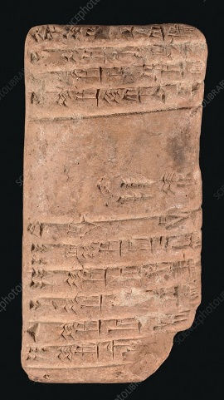
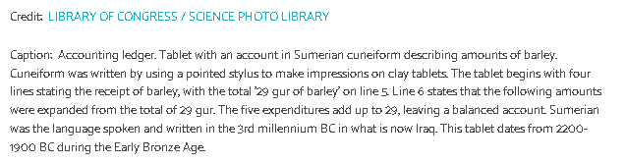
What tasks to automate, and why ?
Since the dawn of time, information-related tasks have been undertaken.
Listing the goods traded,
Tracking the growth of crops and herds,
Checking movement in and out of storage
Later, double entry bookkeeping (15th century, Italy)
We are not the first or the last to deal with data-related tasks.
They are here to stay, so it makes sense to be able to perform them efficiently and without mistake.

Slide 6
Agenda
What tasks to automate, and why ?
Which tools exist, and what is Robotic Process Automation?
A taxonomy of typical data-related tasks
Combination of techniques for real-world applications

Slide 7
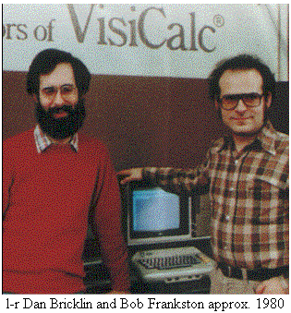
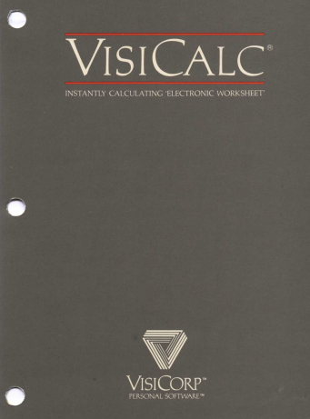
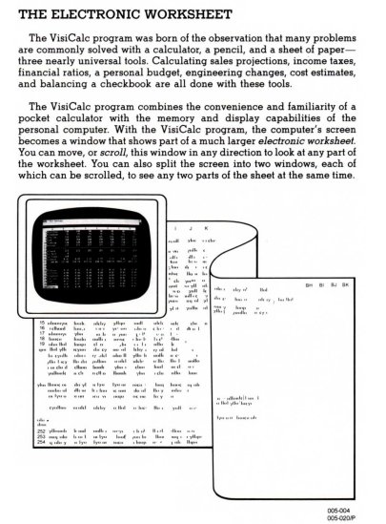
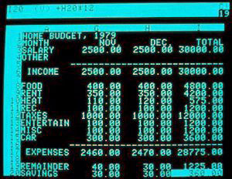
Automation and RPA
Before we delve further into RPA, let’s take a look at the history of efforts to increase the efficiency of data-related tasks.
We perhaps tend to forget, but the first serious business use of computers was due to tablers:
1978: VisiCalc (« Visible Calculator ») is often considered the application that turned the microcomputer from a hobby for computer enthusiasts into a serious business tool. (Lotus 1-2-3 is another example from 1983)
However, as you can see, it was a DOS-based interface, not very user-friendly.

Slide 8
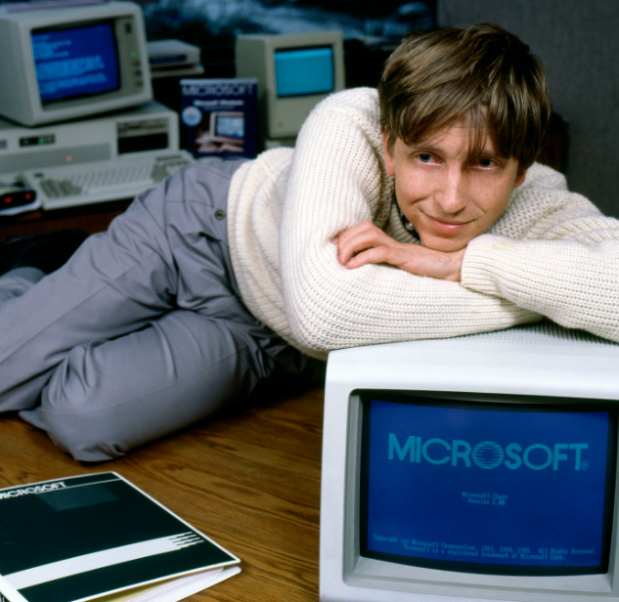
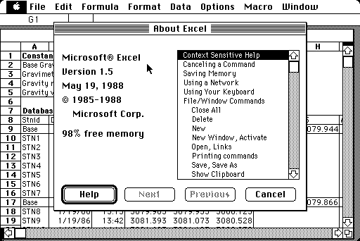
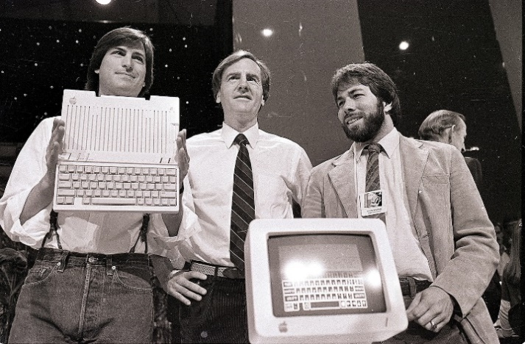
Automation and RPA
One of the great achievements of the early digital revolution was to propose programs (tablers) that could help automate part of these data-related tasks.
Excel was the first tabler which came with a handy graphical user interface, meaning that any user could point & click without knowing anything about programming.
Microsoft Excel :
Excel was originally written for the 512K Apple Macintosh in 1984-1985.
One of the first spreadsheets to use a graphical interface and a point and click capability using a mouse, easier for most people to use than the command line interface of PC-DOS spreadsheet products.
Flagship product of the Windows computers from 1987.

Slide 9
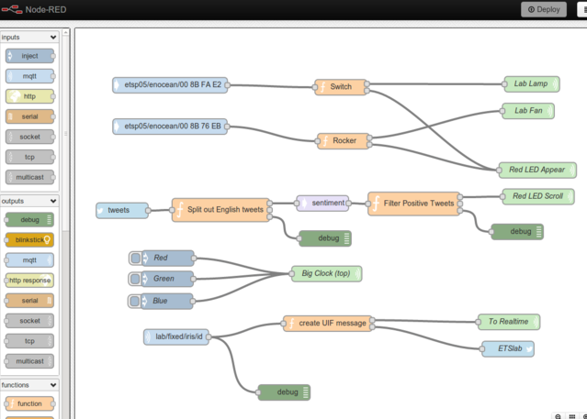
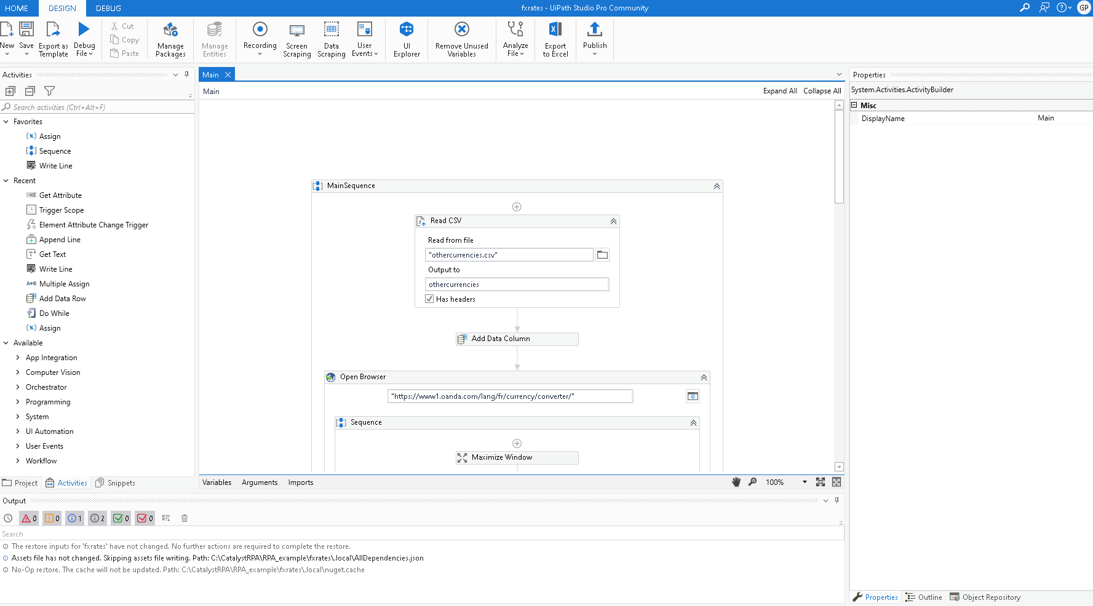
Automation and RPA
There are two main ways to perform a task in computing:
Programming
Text-based programming (creating a program with words)
Visual programming (creating a program with an UI)

Slide 10
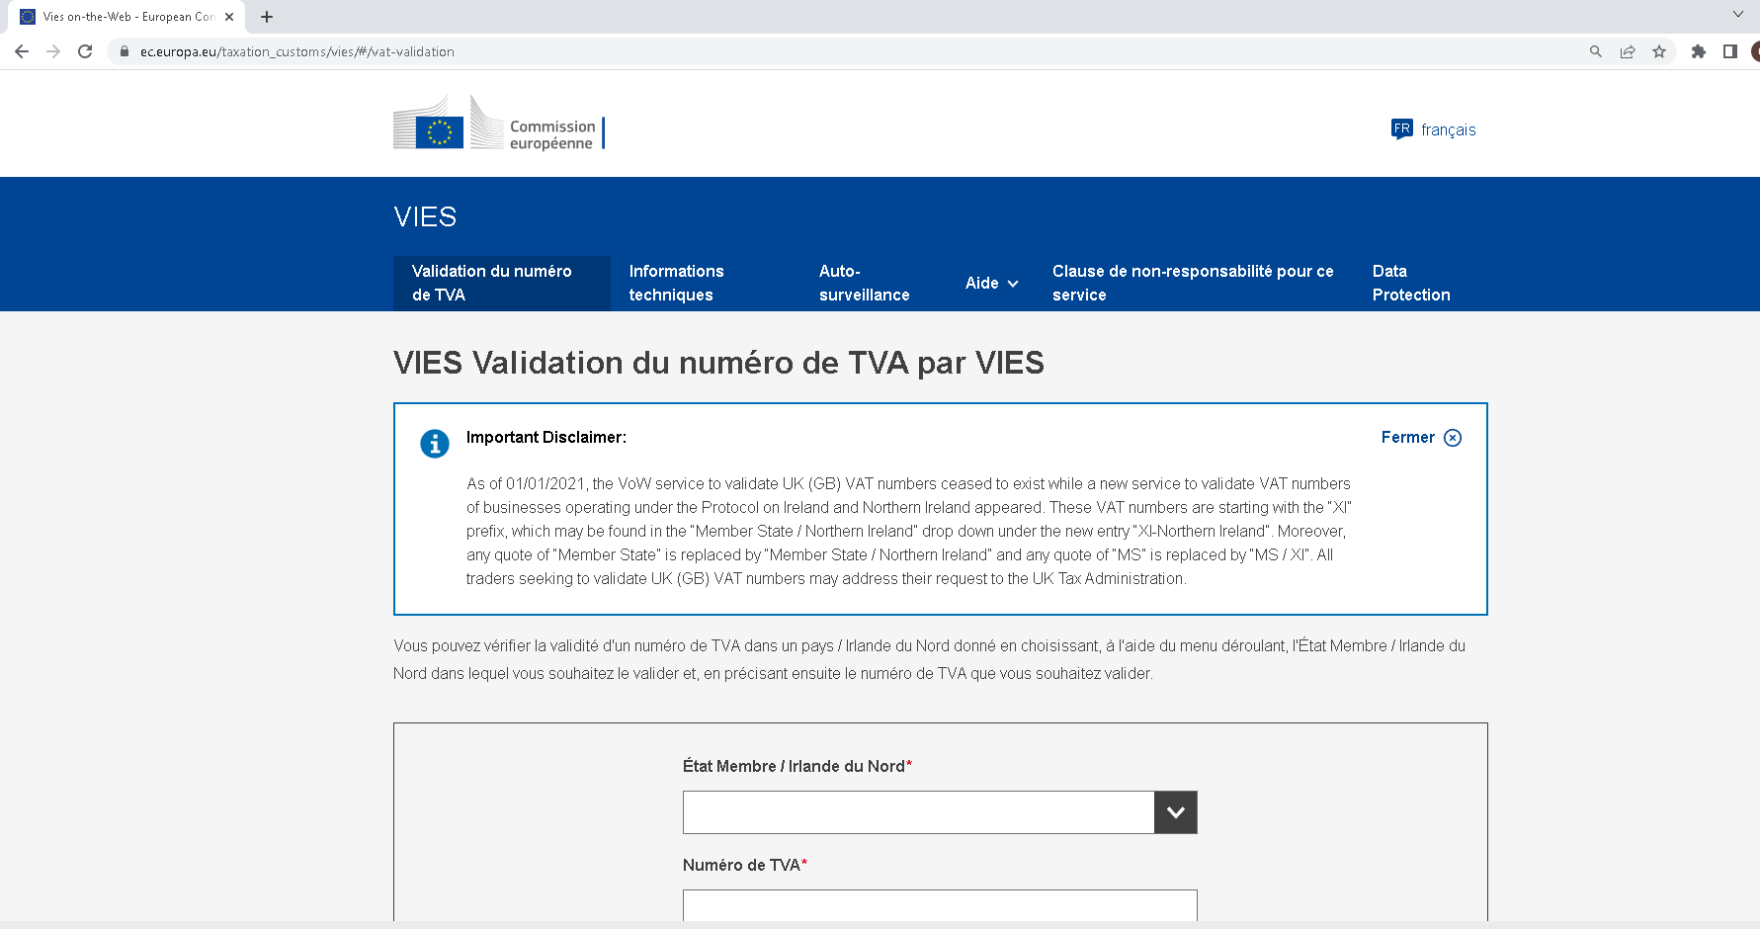
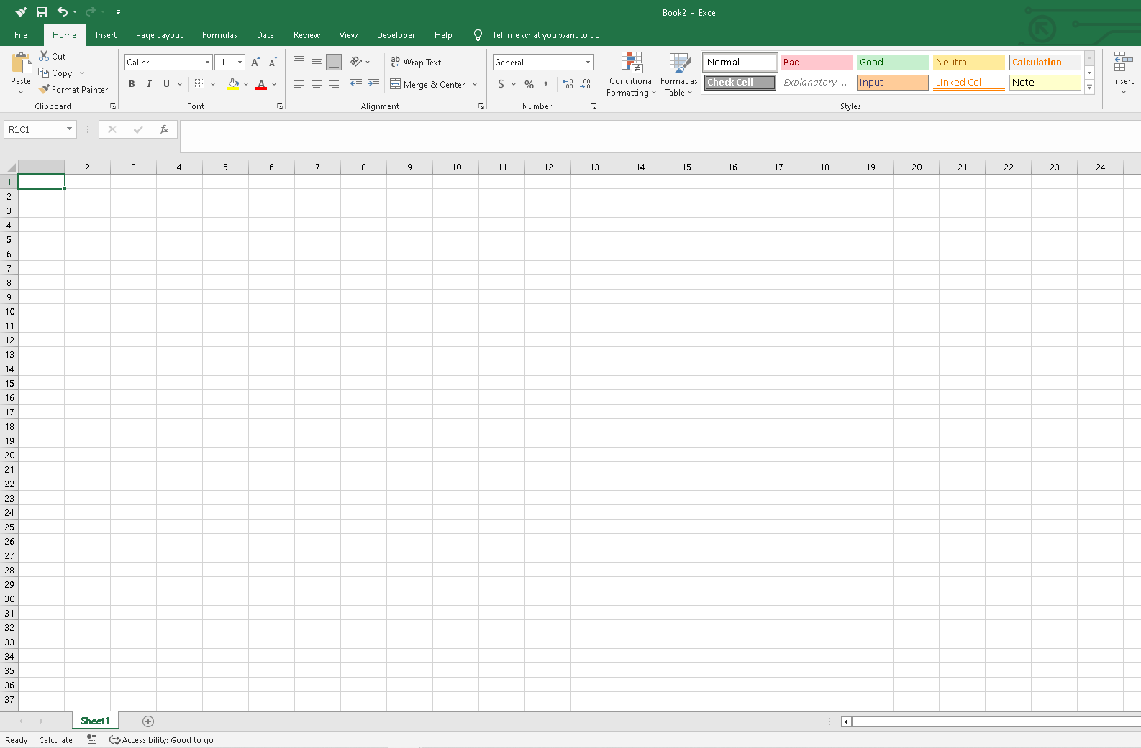
Automation and RPA
In summary, there are two main ways to perform a task in computing:
Via user interfaces, such as:
Excel
Chrome
Any other program that includes an UI (UI‘s belong to programs made via programming techniques)

Slide 11
Automation and RPA
Every automation task starts with the question:
What do I want to automate?
Is it something that involves only data read / write and manipulations?
Example: read the last file from a folder, transform it, and place the results in another folder
Or does it involve manipulating a User Interface?
If it involves UI manipulation, is it strictly web-based UI’s, or are they UI’s running on the local machine?
Different options will be available in terms of tools, depending on these questions

Slide 12
Automation and RPA
Graphical User Interfaces are very good for one-off tasks that don’t repeat
UI’s are easier to use than programming tools
Better for flexible tasks, but do not generalize as well to a number of similar cases
Programming is good for repetitive tasks
A program can perform the same operations on many similar cases
Lacks the flexibility of UI’s
Requires some knowledge of a programming framework.
Due to the worldwide success of User Interfaces, business users now typically interact with many UI’s on a daily basis (Excel, Chrome, Outlook, Gmail, …) and often for similar, repetitive tasks.
Often, these UI-based tasks are repetitive as well.
Robotic Process Automation (RPA) tools are programming tools (often visual-programming) which allow us to create “robots” which automate operations done on User Interfaces, by mimicking the interactions that a user would have with these UI’s. These “robots” can be started remotely from the cloud.

Slide 13
Automation and RPA
Automating the UI‘s: Demonstration of
OpenRPA (Notepad)
Uipath (Currency converter)
Main message 1
RPA tools are visual programming frameworks which can spy different elements of an User Interface and interact with them.

Slide 14
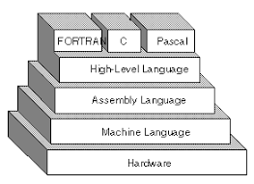
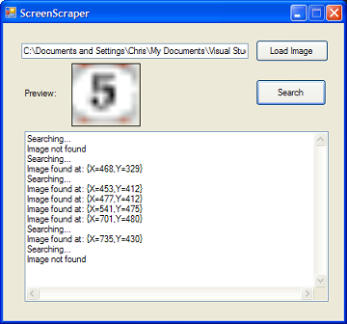
Automation and RPA
Using a computer, we can represent any data-related task as a sequence of different steps (instructions) which take an input and yield an output.
This is what is called a program. Excel is an example of a program which performs data-related tasks.
UI’s automate part of the tasks that used to be possible only via programming. RPA automates the UI’s themselves
1945: early computers, pure programs
70’s-80’s: user Interfaces, democratization of computing for business
90’s: automation of the UI’s themselves using RPA tools
1: Programs
3:Programming the UI’s
2: UI’s

Slide 15
Automation and RPA
Historically UI‘s allowed people to avoid using low-level programming tools such as assembly for simple tasks.
Nowadays, RPA programs allow to create robots (“bots“) which are programs aimed at automating operations done on UI‘s.
RPA tools are visual programming frameworks which can spy different elements of an User Interface and interact with them.
However, since they are one abstraction higher than UI‘s, RPA tools can depend on many graphical parameters of a machine (such as the resolution etc.). They are considered brittle and slower than other programming tools, and should not be used exclusively.
There are different tools that are to be used for different kind of jobs.
Nowadays, many text-based programming languages exist, that make programming way simpler than what it used to be, which decreases the usefulness of UI‘s.
Additionally, the availability of API‘s also increased, further reducing the use of UI‘s and RPA tools.

Slide 16
Automation and RPA
There are two ways to interact with software:
Via a User Interface (UI): made for human users
Via an application programming interface (API), made for two computer programs to be able to talk to each other. Many websites and applications provide an API, such as
Twitter, to post and retrieve tweets automatically
Gmail to programmatically send and retrieve emails
Google search API allows to programatically perform searches
Youtube API allows to display videos from youtube into other websites
API‘s allow to automate tasks done with their systems without the need to go through the User Interface. Programs with an API can be automated without the need for UI’s or RPA tools
3:Programming the UI’s
1: Programs with an API
2: UI’s

Slide 17
Automation and RPA
RPA tools are a subset of visual programmming.
They are considered brittle and slower than other programming tools, and should not be used exclusively.
There are different tools that can automate different kind of tasks.
Task | What tool should be used? | How to use the tool?
Data manipulation | Programming (text-based mostly, or visual) | Using read/write API’s for data input/output
Automate any UI when an API is available | Programming or RPA, but we advise text-based programming Uipath demo googlesearch | We can use either text-based or visual programming tools, including RPA, to interact with the API’s.
Automate a Web-based UI without an API being available | Programming or RPA Selenium demo Uipath demo | Spying and automating the UI elements. If the UI is web-based, we can use text-based programming frameworks such as Selenium in python, C++, …
Automate the UI of locally installed software, without an API being available | RPA | Few programming frameworks allow to efficiently spy UI elements of locally-installed software, apart from RPA tools.

Slide 18
Automation and RPA
Demos

Slide 19
I. Why automate at all ?
It’s (very) possible to have UI-based tasks that are repetitive
What if you have a number of excel files to treat the same way for example, or have to check the validity of a VAT number on the web for many third-parties
Like all computer-based tasks, it is possible to automate them using programming tools.
Programming allows to execute tasks on a number of repetitive cases
UI’s allow to be more flexible and to perform tasks without the need of a programming tool
When the tasks involving UI’s are very repetitive, we can use specific programming tools to automate User Interfaces.
These tools which allow to automate the GUI’s are called RPA tools, for Robotic Process Automation.

Slide 20
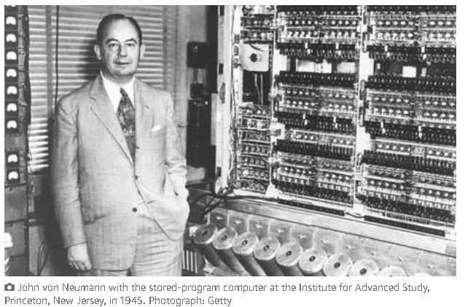
Automation and RPA
Using a computer, we can represent any data-related task as a sequence of different steps (instructions) which take an input and yield an output.
This is what is called a program. Excel is an example of a program which performs data-related tasks.
1945: early computers, pure programs
1970’s:
The principal feature of a von Neumann computer is that the program and any data are both stored together, usually in a slow-to-access storage medium such as a hard disk, and transferred as required to a faster, and more volatile storage medium (RAM) for execution or processing by a central processing unit (CPU).

Slide 21
I. Why automate at all ?
When the tasks involving UI’s are very repetitive, we can use specific programming tools to automate User Interfaces.
These tools which allow to create programs which automate the GUI’s are called RPA tools, for Robotic Process Automation tools.
Demonstration of UIPath

Slide 22
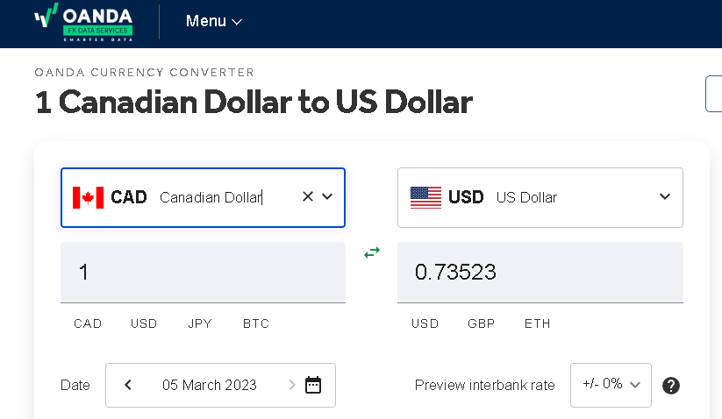
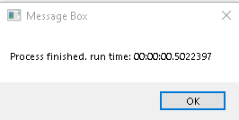
I. Why automate at all ?
Compare:
Web user interfaces: currency converter example
Pure data operations: appending and column-wise operations
Local client User interface: Outlook, SAP, …

Slide 23
I. Why automate at all ?
What are these tools good for?
Programming is good for repetitive tasks
A program can perform the same operations on many similar cases
UI’s are very good for one-off tasks that don’t repeat
UI’s are also easier to use than programming tools
More flexible, but do not generalize to a number of similar cases
Due to the worldwide success of User Interfaces, business users now typically interact with many User Interfaces on a daily basis (Excel, Chrome, Outlook, Gmail, …).
Often, these UI-based tasks are repetitive as well.

Slide 24
I. Why automate at all ?
When the tasks involving UI’s are very repetitive, we can use specific programming tools to automate User Interfaces.
These tools which allow to create programs which automate the GUI’s are called RPA tools, for Robotic Process Automation tools.
Demonstration of UIPath

Slide 25
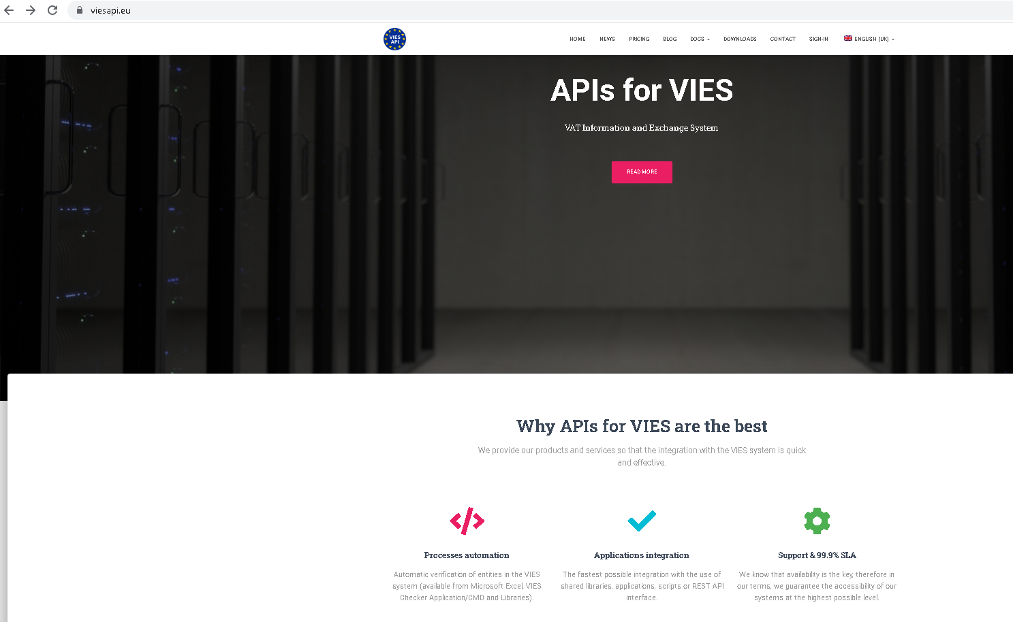
I. Why automate at all ?
It’s (very) possible to have UI-based tasks that are repetitive
what if you have a number of excel files to treat the same way for example, or have to check the validity of a VAT number on the web for many third-parties
Like all repetitive tasks, it is possible to automate them using programming tools. But how?
Some programs and websites include API’s that allow you to access their capabilities programmatically.

Slide 26
I. Why automate at all ?
It’s (very) possible to have UI-based tasks that are repetitive
what if you have a number of excel files to treat the same way for example, or have to check the validity of a VAT number on the web for many third-parties
Like all repetitive tasks, it is possible to automate them using programming tools. But how?
Some programs and websites include API’s that allow you to access their capabilities programmatically.
For database-related tasks, it might be possible to directly access and modify a program’s database,
For simple data-wrangling tasks, it is also possible to simply read, process, and save data in the appropriate format

Slide 27
I. Why automate at all ?
1985: Microsoft Excel :
Excel was originally written for the 512K Apple Macintosh in 1984-1985.
One of the first spreadsheets to use a graphical interface and a point and click capability using a mouse, easier for most people to use than the command line interface of PC-DOS spreadsheet products.
Many people bought Apple Macintoshes so that they could use Bill Gates' Excel spreadsheet program.
When Microsoft launched the Windows operating system in 1987, Excel was one of the first application products released for it. When Windows gained wide acceptance, Excel was Microsoft's flagship product.
It has only received competition from other spreadsheet products since 1992.

Slide 28
I. Why automate at all ?
We went from full programming at the beginning with no GUI’s

Slide 29
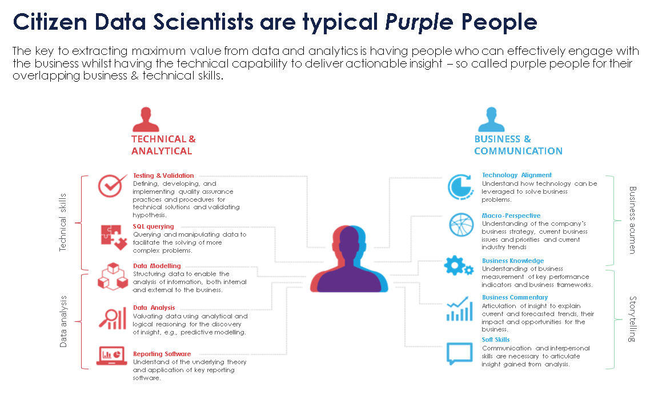
I. Why automate at all ?
How to quantify, say, the increase in productivity from before to after tablers?
Lack of studies and numbers
The Hackett Group study "The World-Class Performance Advantage: Finance“
World-class finance organizations significantly outperform their peer group in finance service delivery cost and productivity, operating at 42% lower cost and with 44% fewer FTE's

Slide 30
I. What can be automated?
Any computation made on data
Browsing most websites
Operations through most graphical user interfaces
Concretely, almost any operation needed to enter or retrieve data into a system, transform these data, send notification emails, etc. can be automated.
There is no practical limit on the number of operations to be made
However, the tools used will depend on the target system and operations. Some tools are much better suited to one type of operations than another

Slide 31
I. What can be automated?
3 main types of operations that can be automated:
Manipulation of a GUI (doesn’t matter if for data input, output, sending emails, etc.)
Different tools can be applied to Local GUI’s vs Web-based GUI’s
Data manipulation
Calling the API of an application

Slide 32
I. What tools are available?
Tools: Visual and classical programming
Method: API’s or GUI

Slide 33
I. What can be automated?
Let’s break down
Any computation made on data
Browsing most websites
Operations through most graphical user interfaces
Concretely, almost any operation needed to enter or retrieve data into a system, transform these data, send notification emails, etc. can be automated.
There is no practical limit on the number of operations to be made

Slide 34
Warning
The knowledge provided by this document is purely informative. Although the House of Training does its utmost to ensure that this information is correct and up to date, it declines any responsibility as to possible damages, losses, losses of earnings, direct or indirect induced by its use.
The contents are subject to the laws of copyright, all rights reserved.

